Slide 1
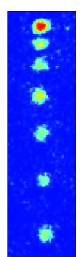
Atom lasers
MIT
1997
Yale
1998
NIST
1999
Munich
1999
FOMO summer school 2016
Florian Schreck, University of Amsterdam

Slide 2
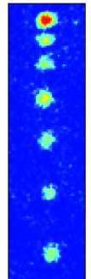
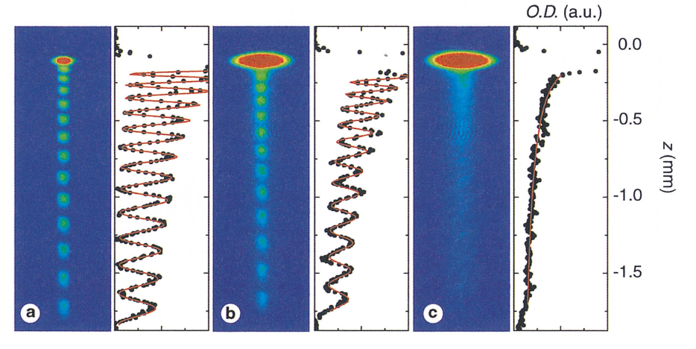
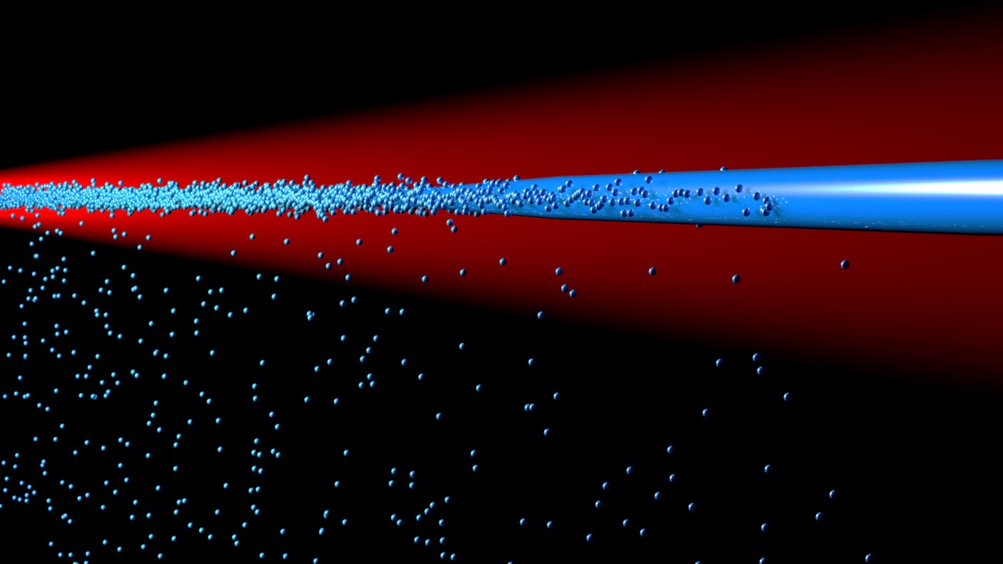
Overview
What? Why?
Pulsed atom lasers
Experiments with atom lasers
Continuous atom lasers

Slide 3
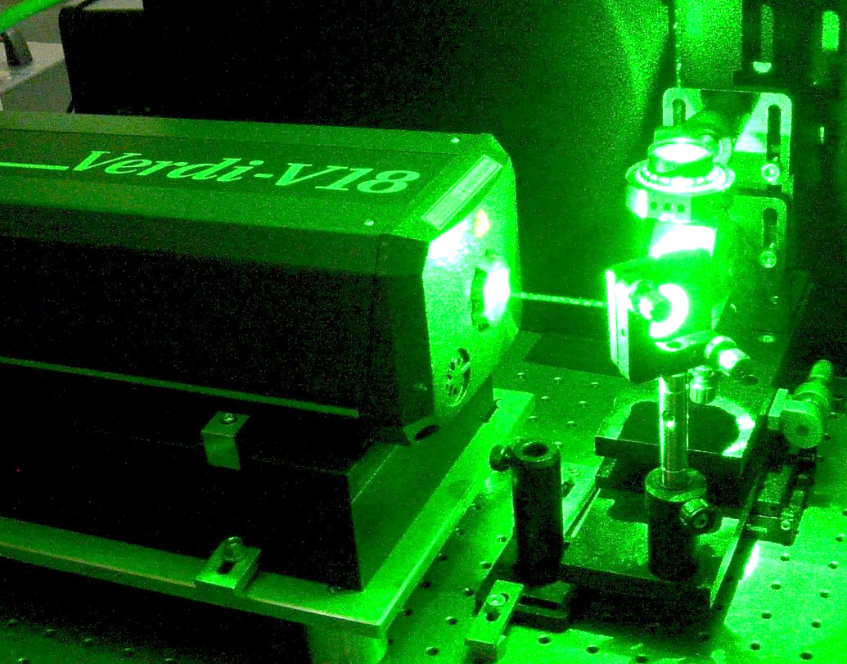
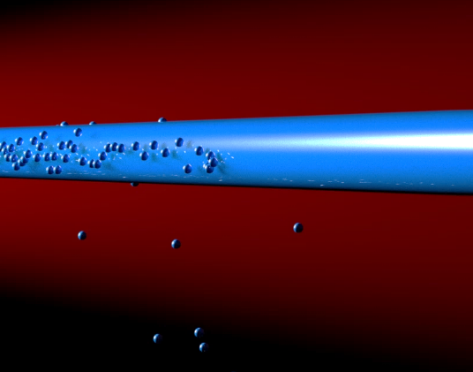
What is an atom laser?
Laser
Light
Matter
Optical laser
Atom laser

Slide 4
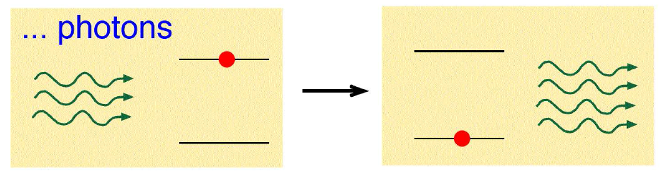
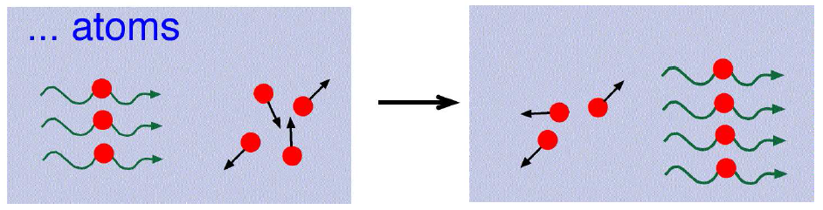
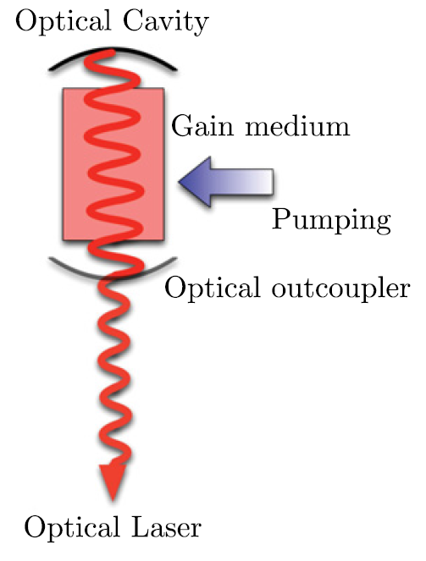
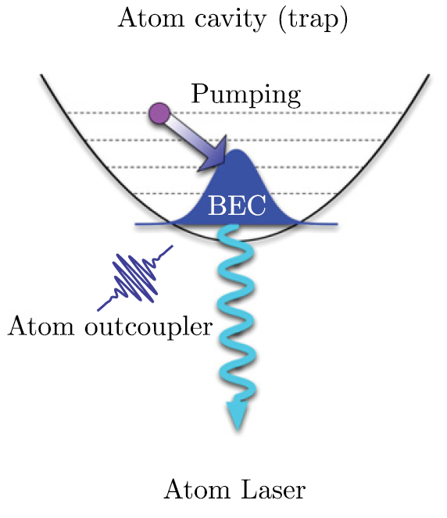
LASER
Light Amplification by Stimulated Emission of Radiation
Optical laser
Atom laser
Stimulated emission
Stimulated scattering
Propagating Matterwave Amplification by Stimulated Scattering of Atoms
PMASSA
Figure from [1] N.P. Robins, P.A. Altin, J.E. Debs, J.D. Close, Physics Reports 529, 265 (2013)

Slide 5
Atom laser vs. thermal beam
Atom laser
Thermal beam
Radial coherence
1 mode
macroscopically occupied
many mode
very weakly occupied
Longitudinal coherence
monochromatic
= extremely small velocity spread
white
= large velocity spread
Velocity
mm/s to cm/s
m/s to km/s
Correlation g₂(0)
1
2
probability to find two atoms at once
* normalization
Source area
1...100 µm diameter
0.1...10 mm diameter
Divergence
Heisenberg limited
typically several degrees
Flux
10⁵ to 10⁷ atoms/s
Zeeman slowed: 10¹¹ atoms/s
Brightness
10²⁴ atoms s² m⁻⁵
10¹⁶ atoms s² m⁻⁵
flux of atoms per source size /
velocity spreads in each dimension
(Rb 2D MOT)

Slide 6
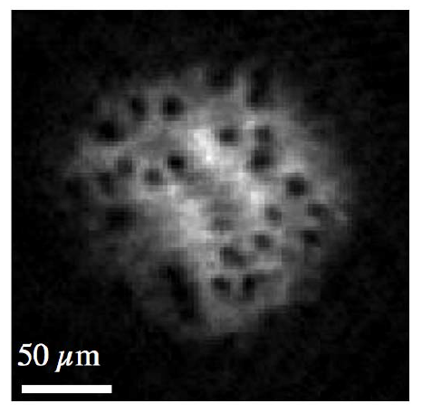
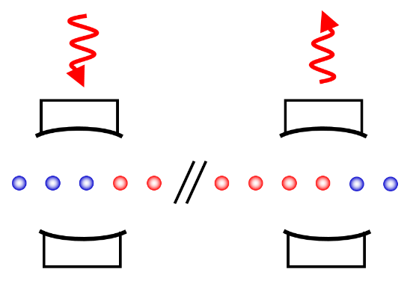
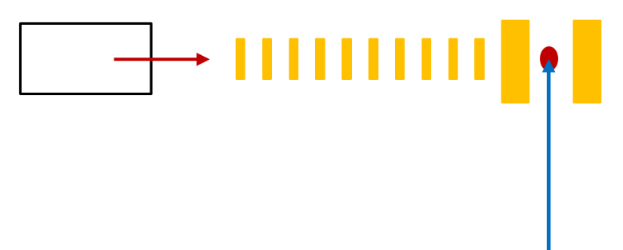
Why atom lasers?
Precision measurement
Studies of quantum mechanics
Anderson group
Atom interferometry
Superradiant mHz-linewidth laser
Dissipative driven systems
Quantum turbulence
Quantum technology
Technology
Cold e⁻ or ion sources
Perpetual sympathetic cooling reservoir
Lithography
Conversion into chain of atoms
Quantum FIFO memory

Slide 7
Why atom lasers for interferometry?
Disadvantages compared to standard MOT based atom interferometers
higher experimental complexity
lower flux
Advantages
Higher brightness: higher flux of usable atoms, e.g. atoms within flat region of Bragg beams
Possibility of squeezing: trade atom-number stability for phase stability
No Dick effect: if continuous atom laser used

Slide 8
The Dick effect
Traditional atom interferometers work in pulsed mode
perform measurement process
load MOT
To measure quantity of interest with high precision, we need to average many measurements.
We cannot resolve fast fluctuation of quantity of interest.
Measure fluctuating quantity:
Result
True average
Error!
dead time
measurement time
Dick effect
noise with same frequency as measurement repetition frequency is sampled incorrectly
Remedies
alternate two measurement devices and average results
measure continuously use continuous atom laser

Slide 9
Overview
What? Why?
Pulsed atom lasers
Experiments with atom lasers
Continuous atom lasers

Slide 10
State-of-the-art: pulsed atom laser
Laser
Cooling
Evaporative
Cooling
Bose Einstein
Condensation
Outcoupling
Depletion
in trap
time
Laser emission
Outcoupling mechanisms
radiofrequency outcoupling
Raman outcoupling
spilling from dipole trap
MIT
1997
Yale
1998
NIST
1999
Munich
1999
outcoupling from lattice

Slide 11
Radiofrequency outcoupling
Starting point:
atoms in magnetic trap
First realization
Ketterle group, PRL 78, 582 (1997)
short radiofrequency pulses
Outcoupling to non-magnetic state
m_{F}
E
-1
F=1
0
+1
B

Slide 12
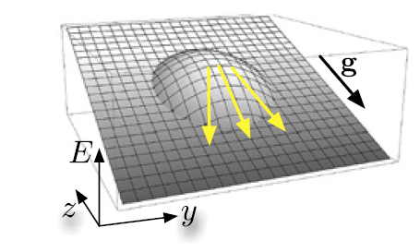
Why this pulse shape?
Magnetic field was unstable
short pulses used to broaden Fourier width
rf pulse addresses all atoms, irrespective of position in trap
each pulse creates “copy” of BEC in m_{F} = 0 state
Each copy falls and expands under influence of mean-field interactions
Trapped BEC
Outcoupled m_{F}=0 BEC
Potential
Potential
external pot.
+ mean-field
gravitational pot.
+ mean-field
gravitational pot.
external pot.
BEC density
BEC density
trapped
outcoupled
Figure from [1]

Slide 13
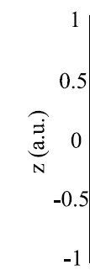
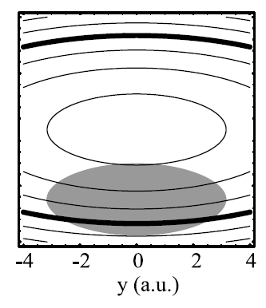
Continuous radiofrequency outcoupling
Very stable magnetic fields allow continuous outcoupling
I. Bloch, T.W. Hänsch, T. Esslinger, PRL 82, 3008 (1999)
continuous radiofrequency has narrow Fourier width
outcoupling occurs at specific locations
Where?
Consider gravitational sagging:
Select outcoupling surface by rf frequency
surfaces of constant |B|
outcoupling surface
magnetic potential
+
gravitationalpotential
BEC
=
total
potential

Slide 14
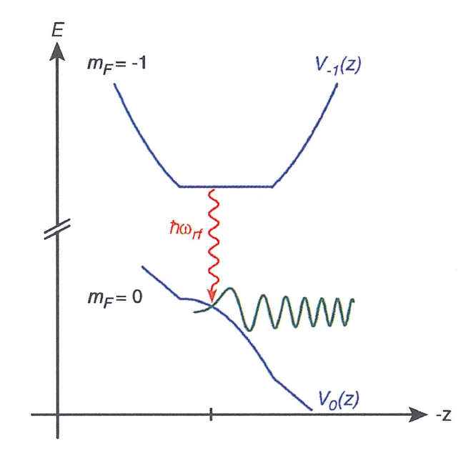
Continuous radiofrequency outcoupling
Very stable magnetic fields allow continuous outcoupling
I. Bloch, T.W. Hänsch, T. Esslinger, PRL 82, 3008 (1999)
solution of Schrödinger eqn. in linear potential = Airy function
Figure from Bloch, Hänsch, Esslinger, Atom lasers and phase coherence of atomic Bose gases, RIKEN review 33 (2001)

Slide 15
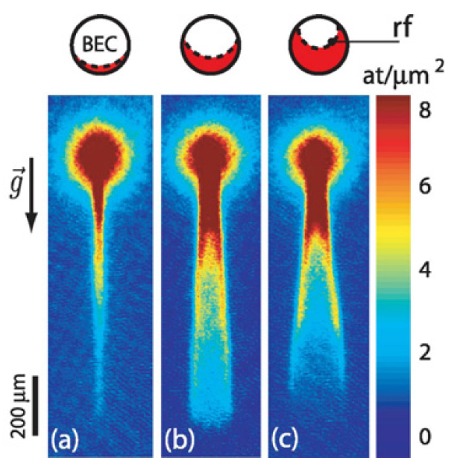
Spatial mode
Mean-field influences expansion
spatial mode depends on outcoupling surface
Esslinger group, PRA 72, 063618 (2005)
Aspect group, PRL 96, 070404 (2006)
Aspect group, PRL 96, 070404 (2006)

Slide 16
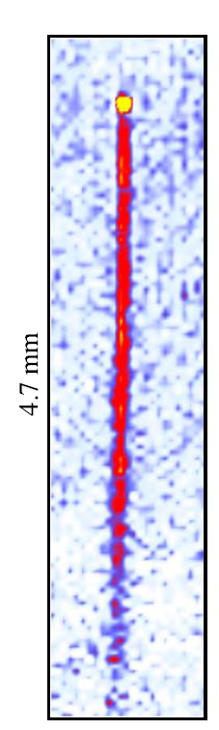
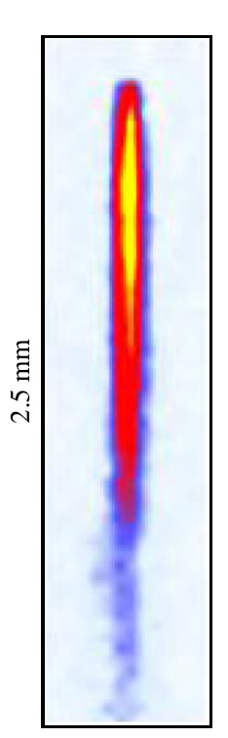
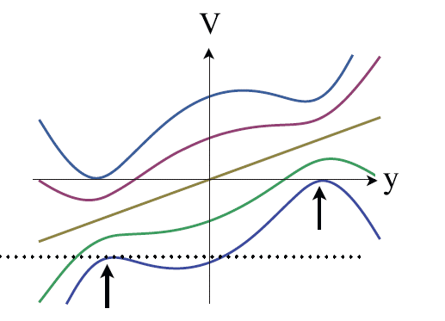
High-flux outcoupling
Uncoupled states
Klitzing group, New J. Phys. 16, 033036 (2014)
V
well-collimated
high-flux
4 x 10⁷ atoms/s
y
Rf dressed states
using strong rf
spilling

Slide 17
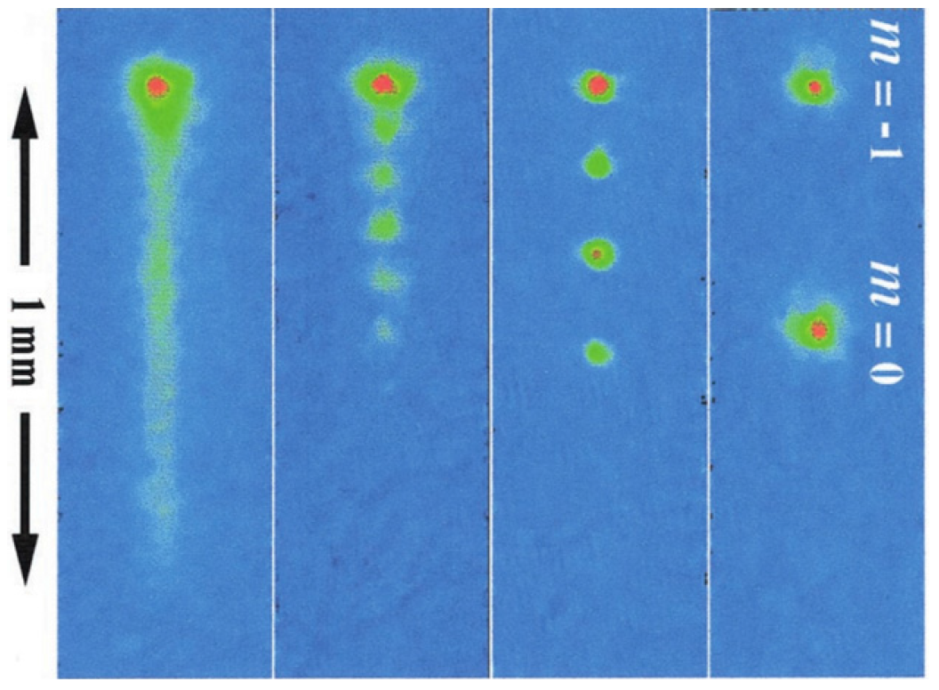
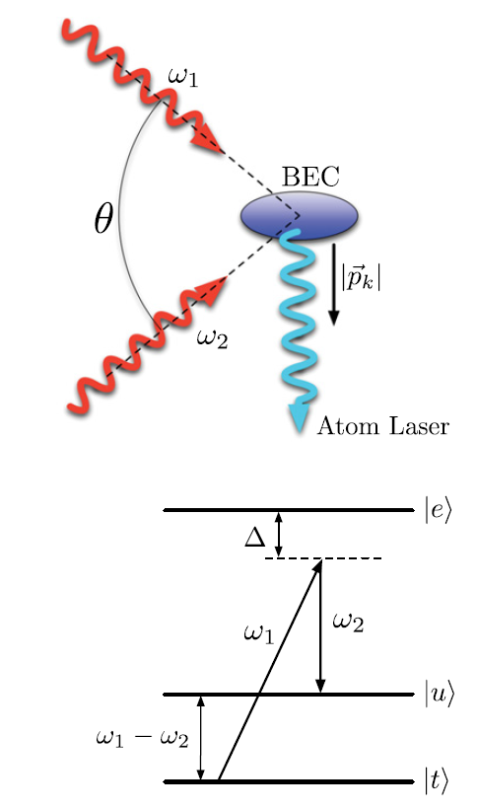
Raman outcoupling
Starting point:
atoms in magnetic or dipole trap
First realization
Phillips group, Science 283, 5408 (1999)
Raman transition imparts momentum
and changes internal state
Here: pulsed operation
(required by time-orbiting-potential magnetic trap)
20 kHz repetition rate: “quasi-continuous”

Slide 18
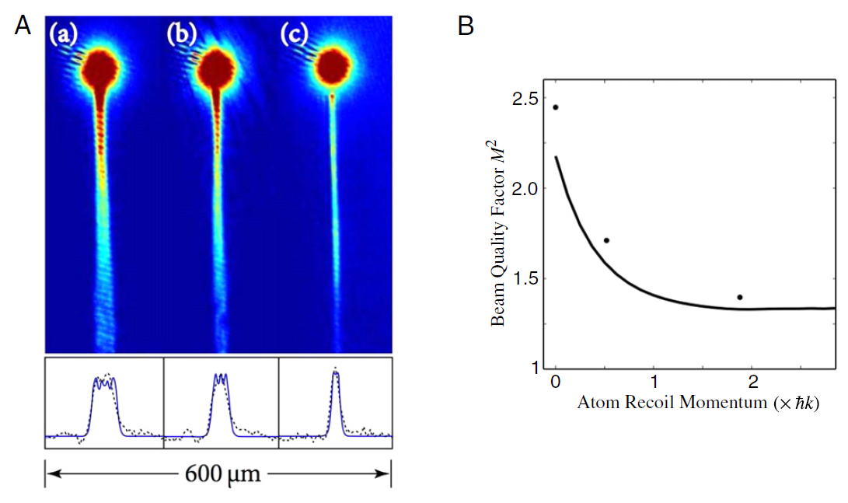
Radiofrequency vs. Raman outcoupling
Raman outcoupling imparts momentum to atom laser
less distortion of spatial mode by mean-field potential
Close group, PR A 77, 063618 (2008)
RF
Raman
Initial velocity:
0 cm/s
0.3 cm/s
1.1 cm/s
initial velocity (cm/s)
0
0.6
1.2

Slide 19
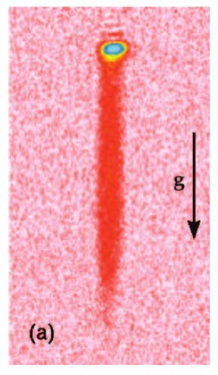
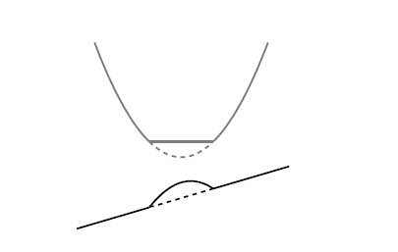
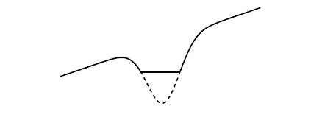
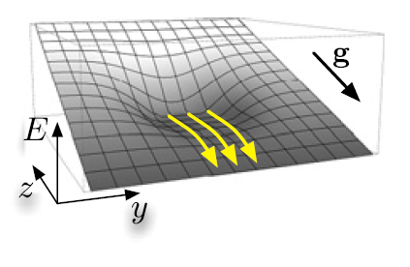
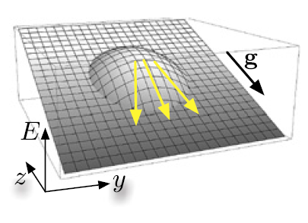
Outcoupling by spilling
Starting point:
atoms in dipole trap
First realization
Weitz group, PRL 91, 240408 (2003)
Gradually reduce intensity of dipole trap beam
Spilling from dipole trap
Rf outcoupling
No repulsive mean-field potential
better beam quality
Figures from [1]

Slide 20
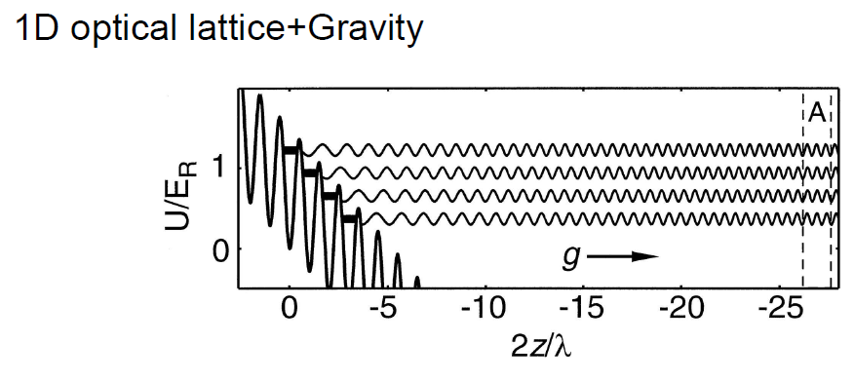
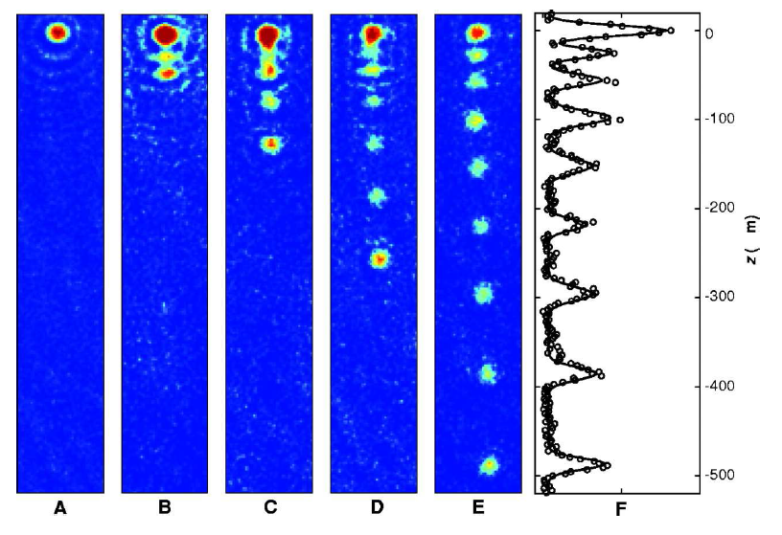
Outcoupling from lattice
Kasevich group, Science 282, 1686 (1998)
Interference of many Airy functions leads to atom laser pulses
(= Bloch oscillations in lattice with partial Bragg reflection)

Slide 21
Overview
What? Why?
Pulsed atom lasers
Experiments with atom lasers
Continuous atom lasers

Slide 22
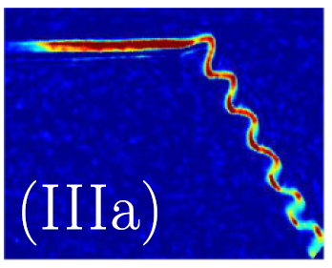
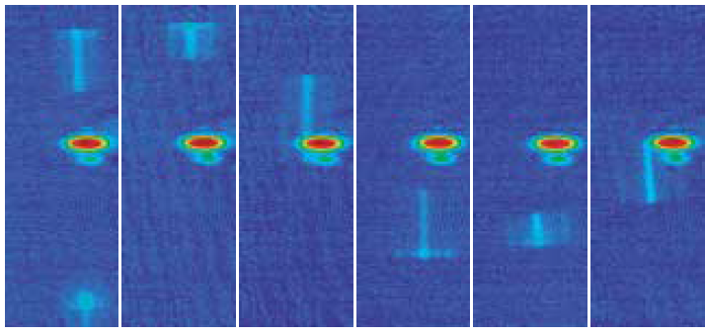
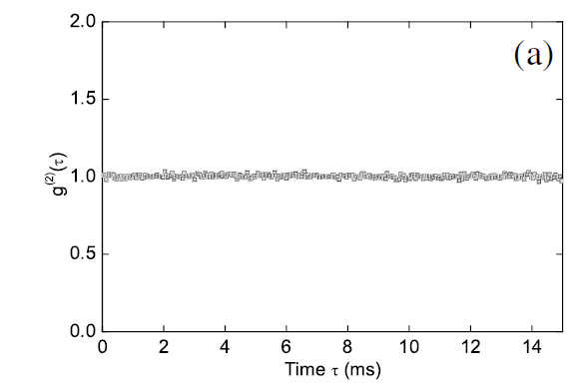
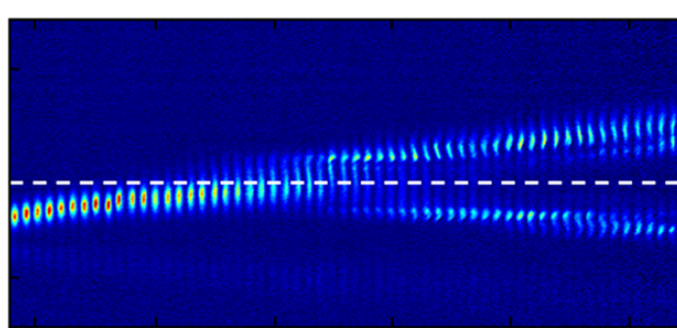
Experiments with atom lasers
Magnetic mirror & resonator
Guided atom lasers
Bragg mirrors and resonator
Coherence and correlations
g⁽²⁾(τ)
time τ (ms)

Slide 23
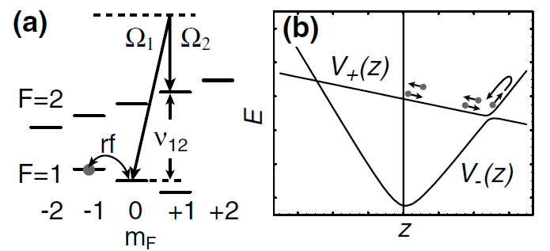
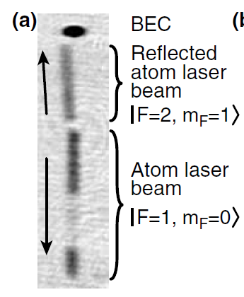
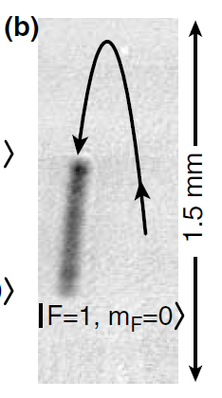
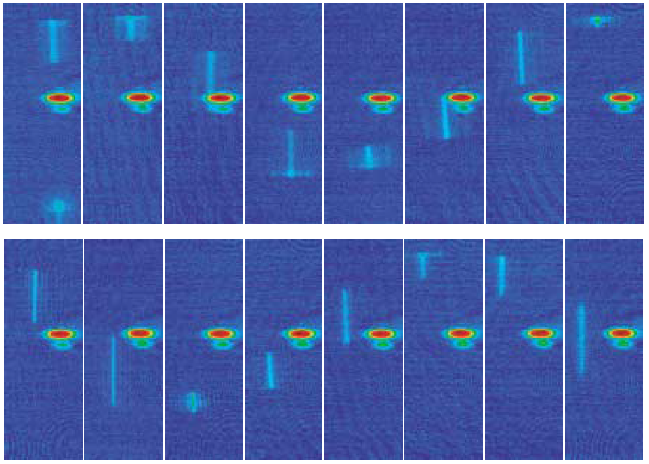
Atom laser mirror and resonator
mirror
Esslinger group, PRL 87, 030401 (2001)
Load resonator
Mirror
Raman briefly on
Raman always on
resonator: V₋ potential
Raman briefly on
load atom laser into resonator
oscillations in resonator

Slide 24
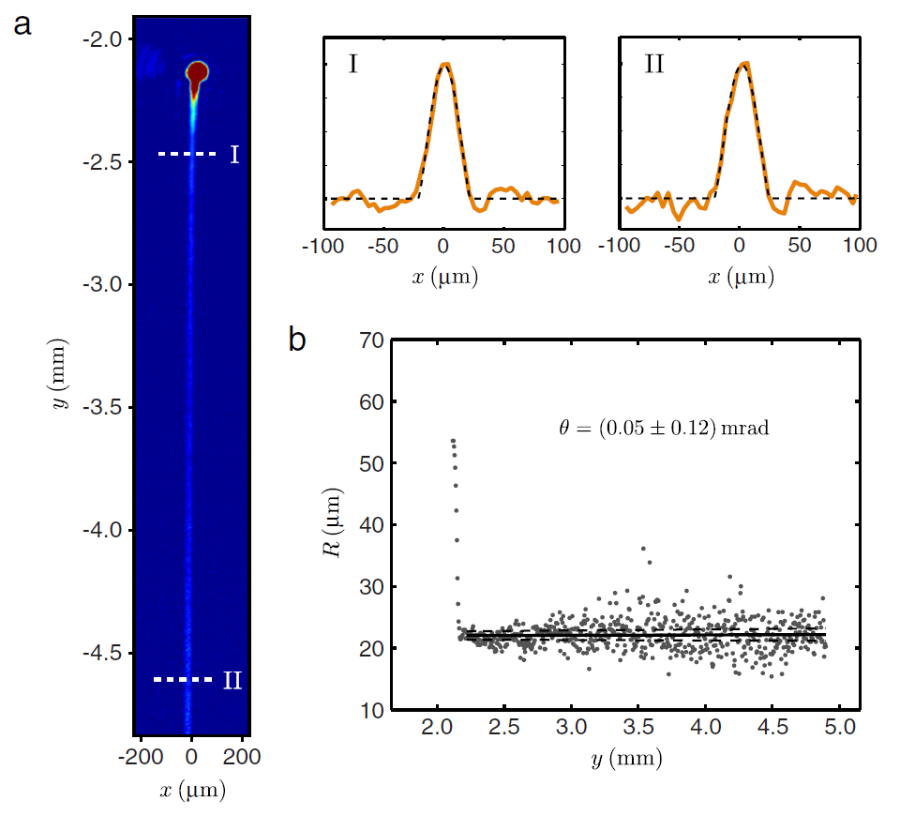
Guided atom lasers
Starting point: BEC in crossed beam dipole trap
Atom laser beam confined in vertical dipole trap improved spatial beam profile
P.A. Altin, Ph.D. thesis, The Australian National University (2012)

Slide 25
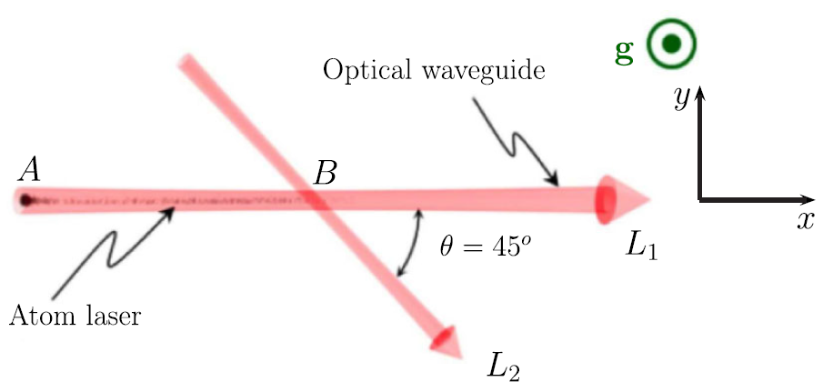
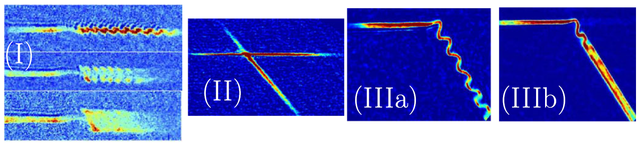
Atom laser beam splitter
Optically guided beam splitter
Guéry-Odelin group, PRL 109, 030403 (2012)
power laser L₂ / power laser L₁

Slide 26
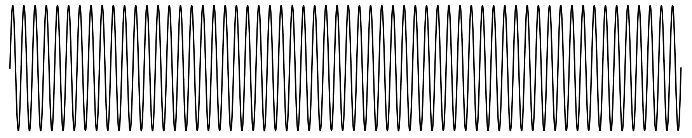
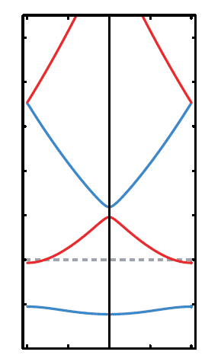
Atom laser Bragg mirror
Guéry-Odelin group, EPL 103, 50006 (2013)
Lattice potential
potential
propagation direction
propagating atom laser
Band structure
energy
forbidden bands
no propagating matter wave at these energies
energy dependent mirror
quasimomentum

Slide 27
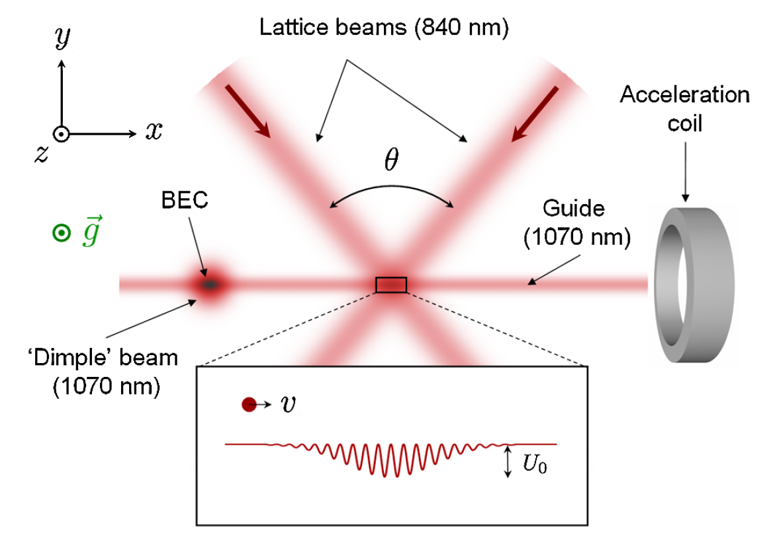
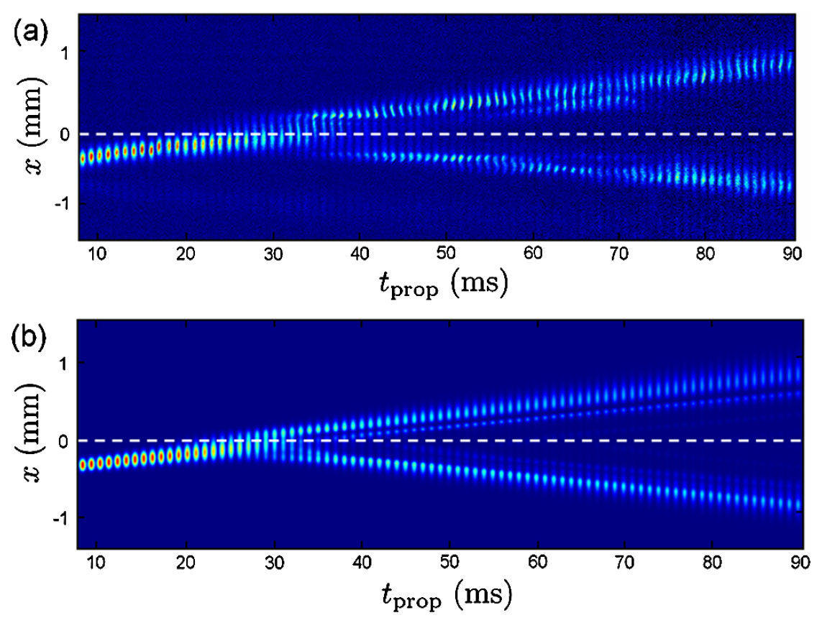
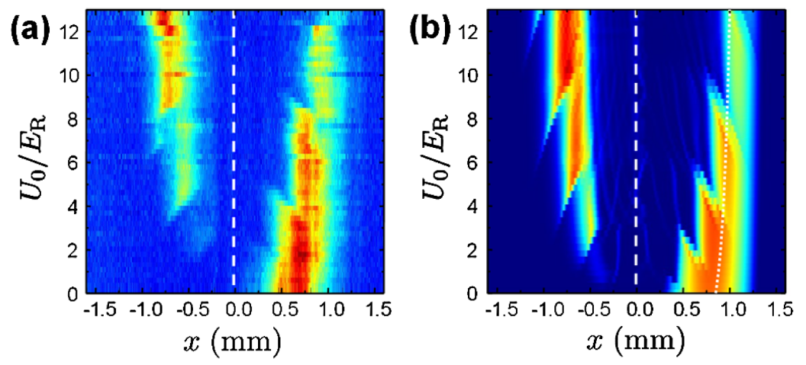
Atom laser Bragg mirror
Guéry-Odelin group, PRL 107, 230401 (2011)
experiment
theory
experiment
theory

Slide 28
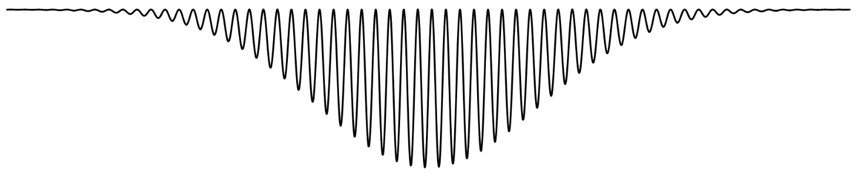
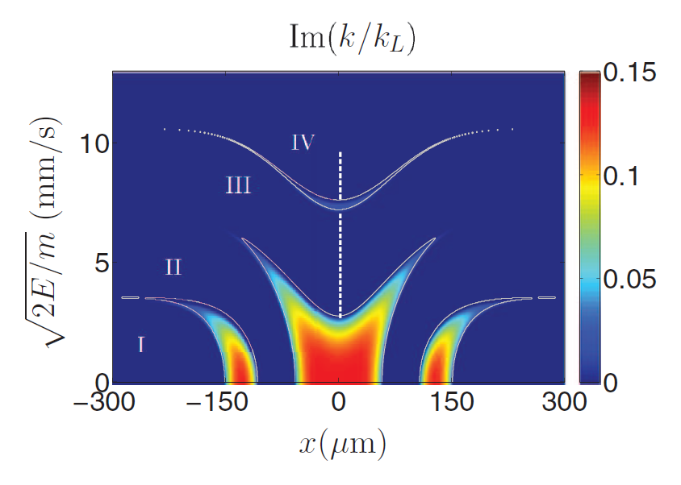
Atom laser Bragg cavity
Guéry-Odelin group, EPL 103, 50006 (2013)
potential
propagation direction
Bragg resonator
forbidden bands

Slide 29
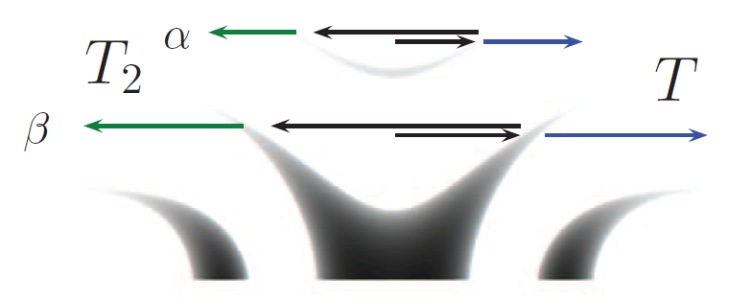
Atom laser Bragg cavity
Guéry-Odelin group, EPL 103, 50006 (2013)
potential
propagation direction
Bragg resonator
2nd reflection /
transmission
1st reflection /
transmission
start
experiment
Procedure
Give atom laser velocity of 9.4mm/s
using B-field gradient
Adiabatically ramp up resonator (in 0.1ms)
Let atom laser evolve
Image
theory

Slide 30



Atom laser Bragg cavity
Guéry-Odelin group, EPL 103, 50006 (2013)
potential
propagation direction
Result
Bragg resonator
experiment
theory

Slide 31

Interfering two atom lasers
Esslinger group, Riken Review No. 33, 6 (2001)
Outcoupling with two radiofrequencies
m_{F}
E
-1
F=1
0
+1
B
surfaces of constant |B|
BEC, displaced by gravity

Slide 32


Interfering two atom lasers
solutions of Schrödinger eqn. in linear potential = Airy function
Interference of atom laser beams:

Slide 33

Spatial coherence of source BEC
Esslinger group, Riken Review No. 33, 6 (2001)
Choose distance between outcoupling surfaces by selecting rf frequencies
T << T_{c}
T < T_{c}
T > T_{c}

Slide 34




Temporal coherence of atom laser
Atom laser reflecting on mirror:
in and outgoing wave packets interfere
Esslinger group, PRL 87, 16040 (2001)
Measurement procedure
Prepare atom laser in F=2, m_{F}=1
Reflect laser on magnetic mirror
Couple atoms to F=2, m_{F}=2 states
with various turning points,
determined by rf. Transfer probability
given by overlap integral.
Separate m_{F}=1 and m_{F}=2 by letting
them oscillate in their different potentials
5) Detect atoms, count m_{F}=1 and m_{F}=2
Fringes would smear out if no temporal coherence
measure fringes to measure coherence
Fringes have spacing of 150 nm too small to be imaged
Perform spectroscopy
exploit variation in wavefunction overlap
atom laser linewidth ~700 Hz

Slide 35

Spatial correlations
1D atomic beams with same density, but different spatial correlations:
Bunching
uncorrelated
Antibunching
Correlations contain interesting information about quantum system.
They can e.g. be used to distinguish different quantum phases.

Slide 36


Correlation function of atom laser
Esslinger group, PRL 95, 090404 (2005)
g⁽²⁾(τ) = likelyhood to detect a 2nd photon a time τ after having detected a 1st photon

Slide 37

Correlation function of “thermal” beam
Use noisy radiofrequency for outcoupling to simulate thermal beam.

Slide 38
Overview
What? Why?
Pulsed atom lasers
Experiments with atom lasers
Continuous atom lasers

Slide 39
Cooling steps
Step 1: laser cooling
Step 2: evaporative cooling
Not easy to combine:
atom at standstill (BEC atom)
Laser cooling photons can heat up quantum gas

Slide 40



Perpetual BEC
Ketterle group, Science 296, 2193 (2002)
Separate vacuum chamber in BEC production chamber and BEC storage chamber (“science chamber”)
Create BEC here
Store BEC here
Transport and merging
Block MOT straylight by movable shutter
Atom number in stored BEC
It should be possible to outcouple continuous atom laser (~10⁵ atoms/s, phase jump when merging)

Slide 41







Atom laser with pumping mechanism
Close group, Nature Phys. 4, 731 (2008)

Slide 42

Creating continuous atom laser
State-of-the-art: pulsed atom laser
Laser
Cooling
Evaporative
Cooling
Bose Einstein
Condensation
Outcoupling
Depletion
in trap
time
Laser emission
Vision: time space : perpetual atom laser
Laser
Cooling
Evaporative
Cooling
Bose Einstein
Condensation
in atom laser
guide
space

Slide 43

Evaporative cooling of guided atoms
Guéry-Odelin group, PR A 72, 033411 (2005)
MOT
beam from oven
Zeeman slower
atomic beam in 2D quadrupole guide

Slide 44

Evaporative cooling of guided atoms
Operating procedure
Every 100ms
accumulate 10⁹ atoms in MOT
push those atoms into magnetic guide
Reduce forward velocity by climbing hill
Let packets of atoms overlap to form beam
Perform evaporation while beam drifts along guide
detect atoms by fluorescence
determine
flux
forward velocity
radial temperature
Phase-space density evolution
factor 10 increase
MOT: 10⁻⁵
start guide: 10⁻⁷
end guide: 10⁻⁶

Slide 45



Continuous loading of magnetic trap
Vogels group, PhD thesis Louise Kindt (2011)
Plan: add 8m quadrupole guide for evaporative cooling

Slide 46

Compact magnetic guide
Bend guide into the form of a spiral
Raithel group, arXiv:1202.0479

Slide 47

Continuous loading of magnetic trap
Klempt group, J. Phys. B 48, 165301 (2015)
atoms accumulate in trap
by elastic collisions
N = 4 x 10⁷
T = 0.1 mK
PSD = 10⁻⁷

Slide 48


High-flux source of guided atoms
Pfau group, J. Phys. B 42, 145306 (2009)
Atoms in probe region

Slide 49



Continuous loading of optical trap
Pfau group, PRL 106, 163002 (2011)
magnetic guide
+ optical guide
+ magnetic barrier
+ optical pumping
only trapped atoms
N = 2 x 10⁵
T = 0.2 mK
PSD = 3 x 10⁻⁶

Slide 50


Building a perpetual atom laser

Slide 51


Our new tricks
Strontium
Laser cooling
on narrow transition
Transparency beam
Phase-space density = 0.1
BEC in thermal cloud

Slide 52


Narrow line cooling
hot blue MOT
T ~ 1 mK
PSD > 10⁻⁶
¹P₁
cold red MOT
T ~ 1 µK
PSD ~ 0.1
³P_{J}
blue MOT
461 nm
30 MHz
2
1
J
0
red MOT
689 nm
7.4 kHz
2 mm
¹S₀
Notes:
PR A 61, 061403

Slide 53
Dipole trap
dipole trap
T ~ 1 µK
PSD ~ 0.1
laser cooling

Slide 54


Why not more?
Photons heat slowest atoms.
Let‘s make atoms transparent!
atom at standstill (BEC atom)

Slide 55
Transparency beam
dipole trap
¹P₁
³S₁
cooling laser
2
1
J
0
³P_{J}
red MOT
689 nm
7.4 kHz
¹S₀
³P₁
cooling laser
¹S₀
potential

Slide 56
Transparency beam
dipole trap
transparency beam
¹P₁
³S₁
transparency
cooling laser
2
1
J
0
³P_{J}
red MOT
689 nm
7.4 kHz
¹S₀
³P₁
cooling laser
¹S₀
potential

Slide 57
Transparency beam
dipole trap
transparency beam
¹P₁
³S₁
transparency
cooling laser
2
1
J
0
³P_{J}
red MOT
689 nm
7.4 kHz
¹S₀
³P₁
cooling laser
¹S₀
potential
transparency beam

Slide 58


Transparency beam
dipole trap
transparency beam
¹P₁
³S₁
transparency
cooling laser
2
1
J
0
³P_{J}
red MOT
689 nm
7.4 kHz
¹S₀
³P₁
cooling laser
¹S₀
potential
transparency beam
without
with
transparency beam

Slide 59

Transparency beam
dipole trap
transparency beam
¹P₁
³S₁
transparency
cooling laser
Laser cooling to BEC
2
1
J
0
³P_{J}
red MOT
689 nm
7.4 kHz
¹S₀
³P₁
cooling laser
laser cooling alone removes entropy
quantum gas in thermal cloud
¹S₀
potential
transparency beam
without
with
transparency beam

Slide 60

Perpetual atom laser
Requirements:
1) Outcouple atom laser beam
2) Replenish reservoir
Potential landscape for perpetual atom laser:
200
gravity
z (µm)
thermal beam in
atom laser out
-200
0
x (mm)
7

Slide 61

Operation principle and design
Sr beam
source
Zeeman slower
blue MOT
transfer tube
red MOT
atom laser in dipole trap guide

Slide 62




Experimental realization
Building our perpetual atom laser
Spring 2015
Benjamin
Pasquiou
(Veni PI)
Chun-Chia
Chen
(PhD)
Shayne
Bennetts
(PhD)

Slide 63

Experimental realization
Building our perpetual atom laser
Summer 2015

Slide 64
Experimental realization
Building our perpetual atom laser
Winter 2015/16

Slide 65

Experimental realization
Booting up our atom laser
Spring 2016

Slide 66

Experimental realization
Booting up our atom laser
Spring 2016

Slide 67
Booting up the atom laser
Sr beam
source
blue MOT
Zeeman slower
blue MOT
atomic beam
atomic beam
transfer tube
red MOT
atom laser in dipole trap guide
transfer tube
red MOT

Slide 68
Atom transfer
blue MOT
atomic beam
transfer tube
red MOT

Slide 69


Fluorescence images
blue MOT
atomic beam
probe beam
transfer tube
probe beam

Slide 70

Zeeman slower on
blue MOT
atomic beam
probe beam
transfer tube
probe beam

Slide 71

Blue MOT on
blue MOT
atomic beam
probe beam
transfer tube
probe beam

Slide 72


Get colder
blue MOT
atomic beam
red molasses
probe beam
transfer tube
probe beam

Slide 73


Get slower
blue MOT
vertical molasses
atomic beam
red molasses
probe beam
transfer tube
probe beam

Slide 74
Capture atoms
blue MOT
vertical blue molasses
atomic beam
red molasses
transfer tube
vertical slower and
red MOT beams

Slide 75

Capture atoms
blue MOT
vertical blue molasses
atomic beam
red molasses
transfer tube
red MOT
vertical slower and
red MOT beams

Slide 76



Perpetual red MOT
blue MOT
vertical blue molasses
atomic beam
red molasses
transfer tube
perpetual red MOT
N = 10⁹ ⁸⁸Sr
Flux = 10⁸ ⁸⁸Sr/s
T = 50 µK
vertical slower and
red MOT beams

Slide 77

Perpetual narrow-line MOT
blue MOT
vertical blue molasses
atomic beam
red molasses
transfer tube
red MOT
N = 10⁷ ⁸⁸Sr
T = 3 µK
flux = 10⁷ ⁸⁸Sr/s
= 10⁵ ⁸⁴Sr/s
vertical slower and
red MOT beams
(oven T= 410°C, design 540°C)

Slide 78

Time-sequential BEC
atomic beam
transfer tube
Time-sequentially created BEC
dipole trap
BEC lifetime
without blue light: 7s

Slide 79
Stray-light protected BEC
blue MOT
vertical blue molasses
atomic beam
red molasses
transfer tube
Time-sequentially created BEC
dipole trap
BEC lifetime
without blue light: 7s
with blue light: 6s
Straylight protection works!

Slide 80
Towards perpetual BEC
blue MOT
vertical blue molasses
atomic beam
red molasses
transfer tube
dimple beam
dipole trap
transparency beam

Slide 81
Towards perpetual atom laser
blue MOT
vertical blue molasses
atomic beam
red molasses
transfer tube
dimple beam
dipole trap
transparency beam
Raman (Bragg) outcoupled atom laser?

Slide 82

Towards perpetual atom laser
blue MOT
vertical blue molasses
atomic beam
red molasses
transfer tube
Bessel beam guide
+ transparency beam

Slide 83
Why atom lasers?
Precision measurement
Studies of quantum mechanics
Anderson group
Atom interferometry
Superradiant mHz-linewidth laser
Dissipative driven systems
Quantum turbulence
Quantum technology
Technology
Cold e⁻ or ion sources
Perpetual sympathetic cooling reservoir
Lithography
Conversion into chain of atoms
Quantum FIFO memory

Slide 84
mHz-linewidth superradiant laser
Normal clock laser: frequency stability from length of cavity
Superradiant clock laser: frequency stability from ensemble spin of atoms
Need very longlived excited state to conserve spin orientation for long time.
Sr mHz-linewidth clock transition. Minutes lifetime.
How do we get sufficient flux of photons from such a long-lived state?

Slide 85
Phased antennas
Emission of N antennas with random phase:
Electric fields interfere randomly
Total power is N times power of one antenna
Power scales with N
Emission of N antennas with same phase, closer spaced than wavelength
Electric fields interfere constructively
Electric field scales with N
Total power scales with N²

Slide 86
Superradiance
Consider emission of N excited state atoms such that it cannot be known which atom emitted a photon
e.g. - all atoms within volume λ³
- couple all atoms to same cavity mode
After one emission event, superposition state results of all combinations of one atom in ground state and all other in excited state
This is a Dicke state.
It will emit with higher probability into same mode as first photon.
Even stronger entanglement.
Even higher emission probability, just like for phased antennas.
A superradiant flash of light is the result.

Slide 87



Pulsed superradiant laser
Thompson group, arXiv:1603.05671
N = 2 x 10⁵
1.5 x 10⁵
1.25 x 10⁵
10⁵

Slide 88

mHz-linewidth laser
For continuous laser beam:
- ovecome Doppler broadening by confinement in lattice (Lamb-Dicke regime)
repump atoms to metastable state
continuously cool atoms
replenish lost atoms
strontium atom laser beam in
optical clock laser beam out
Theory:
Optical lattice laser, J. Chen, Chinese Science Bulletin 54, 348 (2009), on arXiv 2005.
Prospects for a Millihertz-Linewidth Laser, Meiser et al., PRL 102, 163601 (2009).

Slide 89
Why atom lasers?
Precision measurement
Studies of quantum mechanics
Anderson group
Atom interferometry
Superradiant mHz-linewidth laser
Dissipative driven systems
Quantum turbulence
Quantum technology
Technology
Cold e⁻ or ion sources
Perpetual sympathetic cooling reservoir
Lithography
Conversion into chain of atoms
Quantum FIFO memory

Slide 90
Quantum turbulence
sideview
atom laser sheet
barrier(s)
topview
Mach cones, vortices,…
similar to Anderson group, arXiv:1303.4764

Slide 91
Quantum FIFO memory
row of individual atoms
select and blow out unwanted atoms
moving lattice with 2D BECs
write cavity
read cavity
lattice in radial directions
Mott insulator transition
Create infinite row of individual atoms
Store quantum information in atoms using cavity
Retrieve quantum information later using second cavity

Slide 92
Sympathetic cooling
Goal: ultracold gas or quantum gas of atoms or molecules without laser cooling transition
supersonic beam source
Magnetic trap
stores cold atoms or molecules
Stark or Zeeman decelerator
guided ultracold Sr beam
Sr is non-magnetic enters magnetic trap region without accelerating
Sr evaporates after colliding with target species
Target species cooled
Usages
precision spectroscopy of target species
ultracold chemistry
Few- and many-body physics

Slide 93
Summary
What? Why?
Pulsed atom lasers
Experiments with atom lasers
Continuous atom lasers

